Slide 1
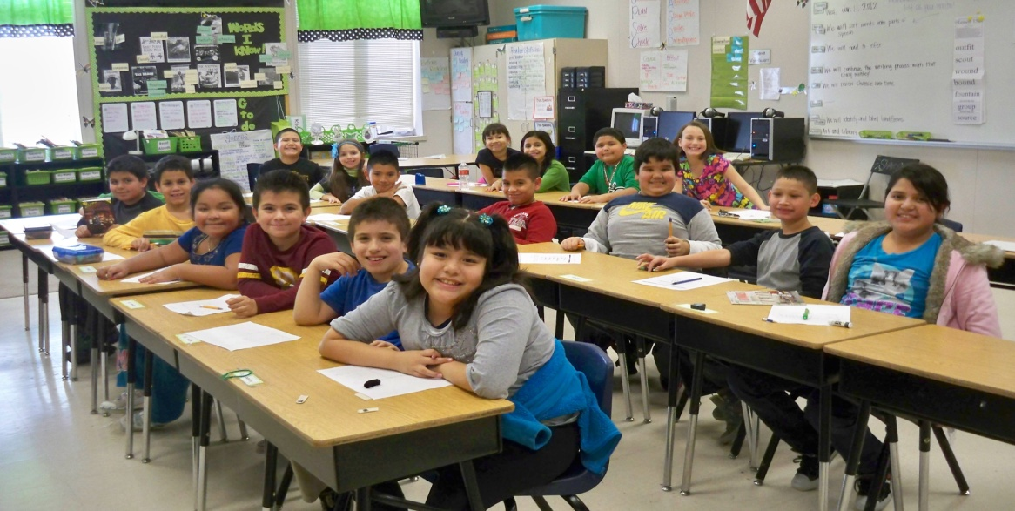
Inferring
Mrs. Manning’s Third Grade Class
Russell D. Jones Elementary
Rogers, Arkansas
January 10, 2012
K. Maloney
Rogers Public Schools

Slide 2

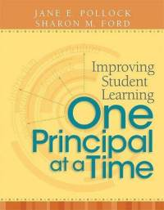
GANAG is a lesson structure that allows teachers to plan for student use of research based instructional strategies.
G= goal
A= access prior knowledge
N= new information
A= application
G= generalize the goal

Slide 3
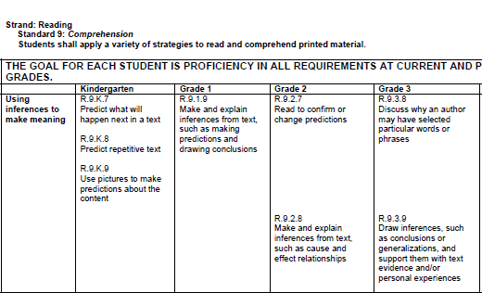
Arkansas English Language Arts Framework
Mrs. Manning started with the standard she wanted the students to perform.
R.9.3.9
Draw inferences, such as conclusions or generalizations, and support them with text evidence and/or personal experiences.

Slide 4
The purpose of the GANAG structure…
To give students the opportunity to actively use the nine high-yield strategies:
(2) Identifying Similarities and Differences
(7) Cooperative Learning
(8) Setting Objectives and Providing Feedback
(3) Summarizing and Note Taking
(4) Reinforcing Effort and Providing Recognition
(9) Generating and Testing Hypotheses
(5) Homework and Practice
(10) Cues, Questions and Advance Organizers
(6) Nonlinguistic Representations

Slide 5
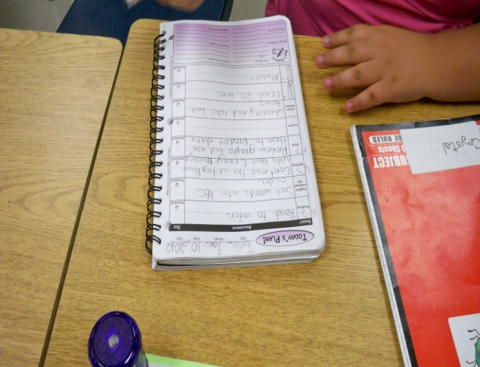
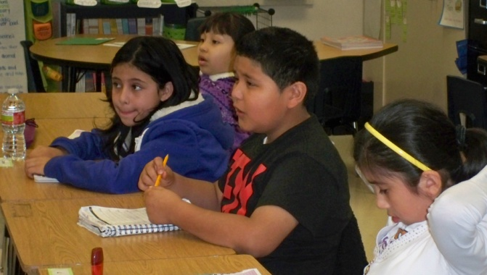
Goal:
Each morning, students write goals for each subject in their planners. Mrs. Manning asked one student to read the goal aloud to the class.
(8) Setting Objectives and Providing Feedback

Slide 6
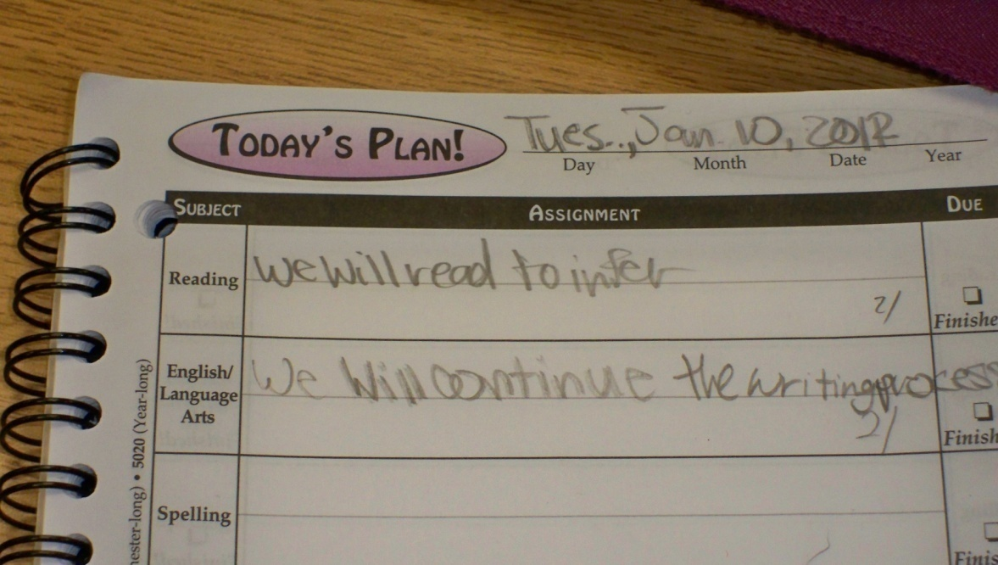
Students scored themselves
next to the written goal in their planners using a 1-4 rubric
at the beginning of the lesson.
(8) Setting Objectives and Providing Feedback

Slide 7
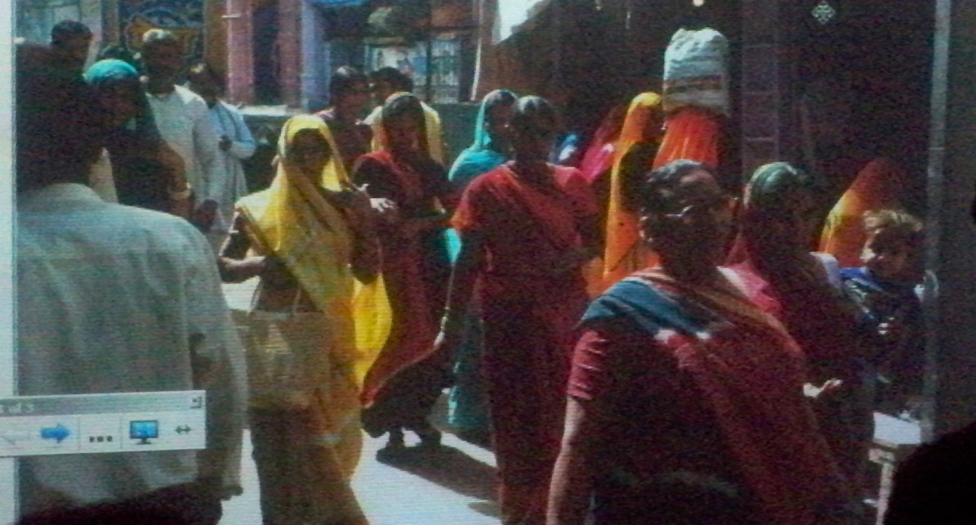
Access Prior Knowledge:
Turn and Talk about this picture…
Where was this picture taken? Who are these people? How are they feeling? What is the time of day?
…and so on…
(10) Cues, Questions and Advance Organizers
(6) Nonlinguistic Representations
(7) Cooperative Learning

Slide 8
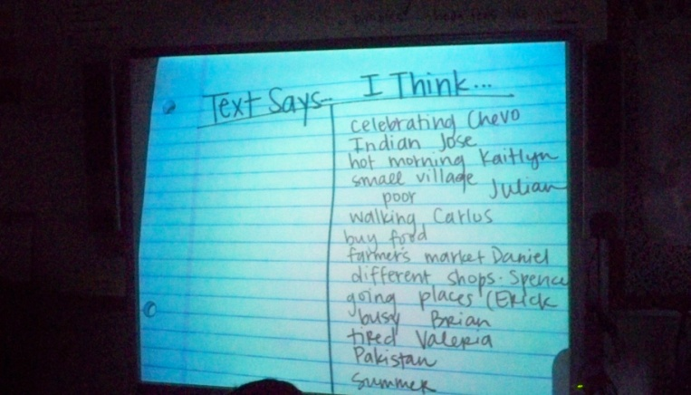
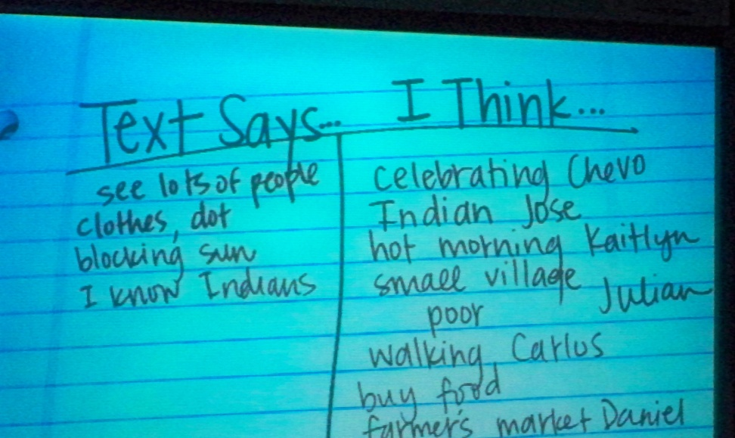
New Information: Modeling
What did you think about?
Mrs. Manning records a list of the students responses using a clipboard and T-Chart.
Mrs. Manning records why the students thought what they did about the picture.
(3) Summarizing and Note Taking

Slide 9
New Information…
“When you used the text (picture) and your background knowledge,
you were inferring.”

Slide 10
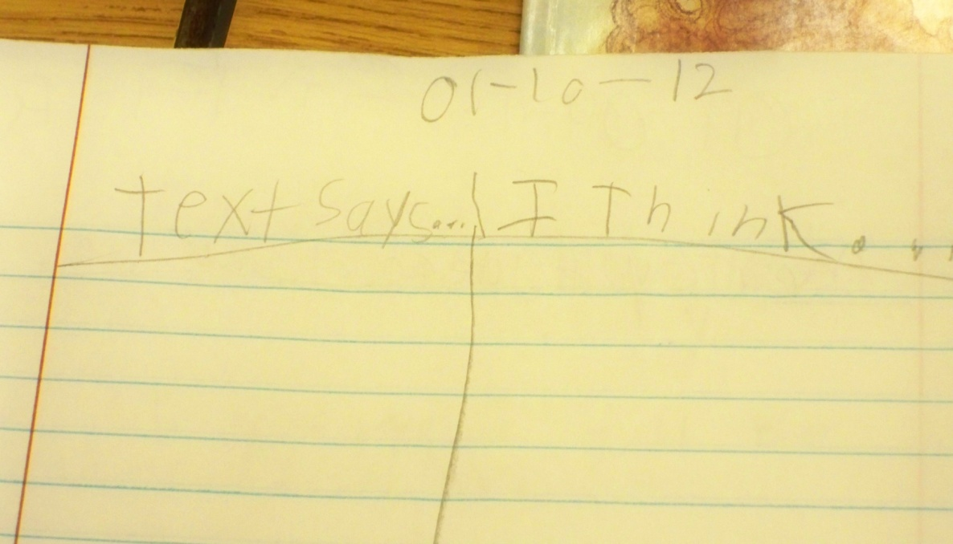
Application:
The students created a T-Chart
in their interactive notebooks
like the one Mrs. Manning used
when modeling.
(10) Cues, Questions and Advance Organizers

Slide 11
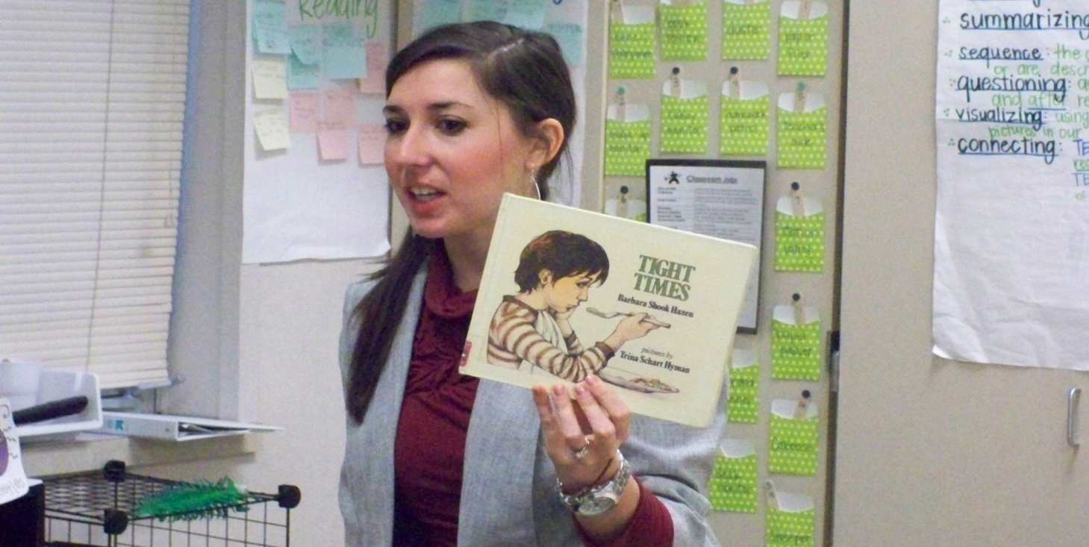
Application:
Mrs. Manning read the story Tight Times aloud to the class.

Slide 12
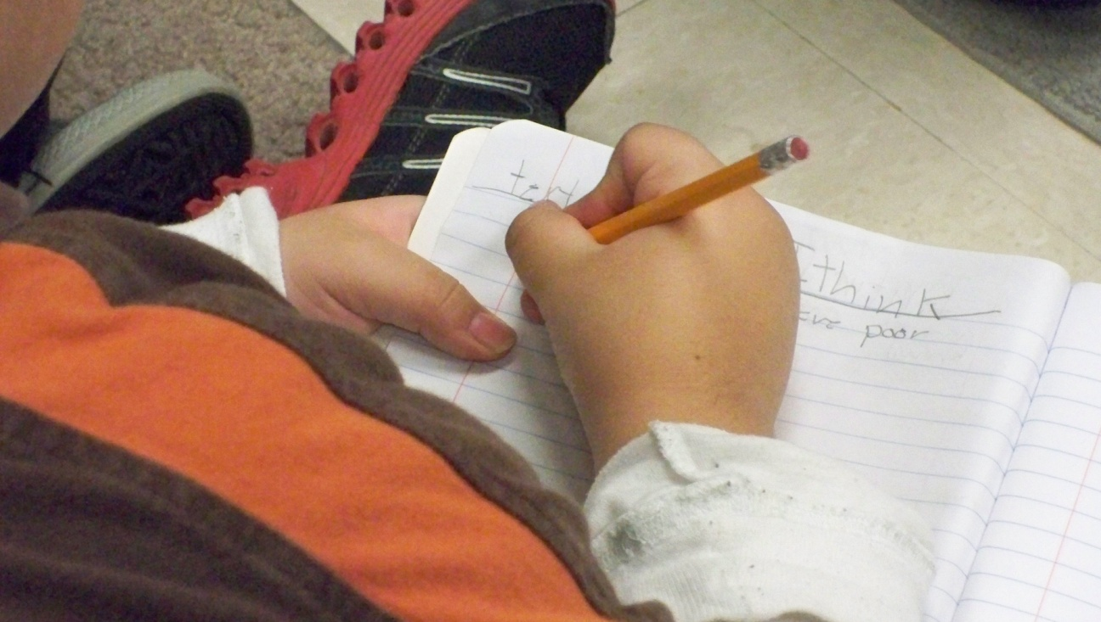
Application:
Students recorded their inferences and evidence from the text.
(3) Summarizing and Note Taking
(5) Homework and Practice

Slide 13
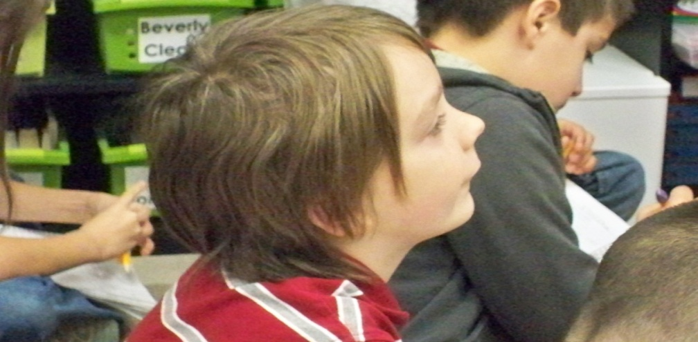
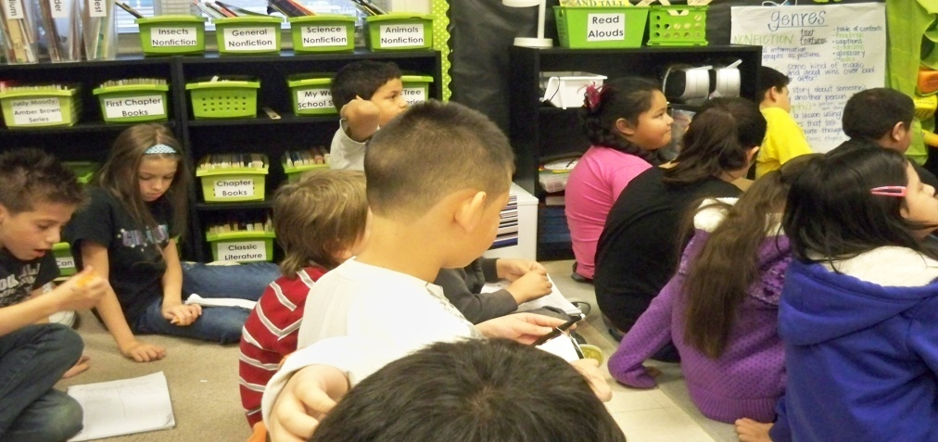
Application:
Students shared some of their examples.
(4) Reinforcing Effort and Providing Recognition

Slide 14
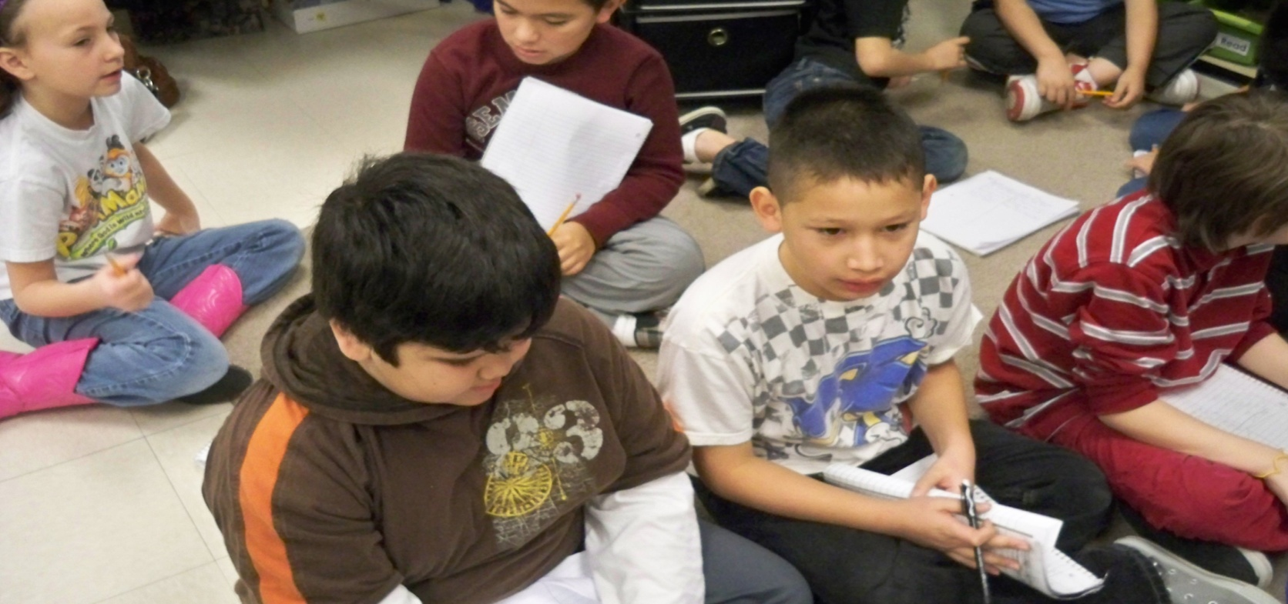
Generalize the Goal…
“Turn and talk to your partner. Tell what you learned about inferring today.”
(8) Setting Objectives and Providing Feedback

Slide 15

Generalize the Goal…
Students returned to their planners after the
lesson and scored themselves to the goal.
(8) Setting Objectives and Providing Feedback

Slide 16
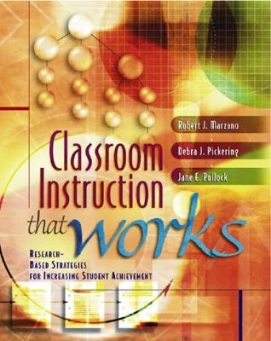
Marzano, R. J., Pickering, D. J., & Pollock, J. E. (2001). Classroom instruction that works: Research-based strategies for increasing student achievement. Alexandria, VA: Association for Supervision and Curriculum Development.
Pollock, J. E. (2007). Improving student learning one teacher at a time. Alexandria, VA: Association for Supervision and Curriculum Development.
Pollock, J. E., & Ford, Sharon M. (2009). Improving student learning one principal at a time. Alexandria, VA: Association for Supervision and Curriculum Development.

